Slide 1

Cognitive Computing
Raghu Prasad
9845547471
www.kaushalya.tech
FB : https://www.facebook.com/raghuprasadkonandur/
Skill Up-Skill Re-Skill
Excellence in action

Slide 2
Introduction
Raghu Prasad – BE, MS
Total of 24 years of experience
7 years as a lecturer in an Engineering College
17 Years into IT
Worked with companies like CISCO,CSC,ICICI,First Apex – NTT Data
Currently into Corporate training and consultancy
Worked with corporates and public sector
Service Offerings – In person/On-line/Corporate/Academic Institutes
Consultancy – Consultant to vendor of Atal Tinkering Lab/ECIL-ECIT, Incarnus – Healthcare Service Provider
Technologies – Java,Python,Web technologies,Java Script technologies (MEAN stack),IOT,Test Automation,Machine Learning,Artificial Intelligence,ERP,.NET
Customers – Philips,L & T,NextGen,Incarnus,Aspire system,BGS-IT,Sindhi College,Malnad Enginering College,S B College of Management, REVA University,Nagarjuna Engineering College,Dayanand Sagar University,NIT-Imphal

Slide 3
Topics
Introduction to Cognitive Computing
Introduction to AI,ML and Deep Learning
Applications of Artificial Intelligence
Applications of AI in Healthcare
History of AI

Slide 4
What is Cognitive Computing ?
Cognitive -
Relating to or involving the processes of thinking and reasoning
Cognitive computing (CC) describes technology platforms that, broadly speaking, are based on the scientific disciplines of artificial intelligence and signal processing. These platforms encompass machine learning, reasoning, natural language processing, speech recognition and vision (object recognition), human–computer interaction, dialog and narrative generation, among other technologies

Slide 5
What is Artificial Intelligence ?
In computer science, artificial intelligence (AI), sometimes called machine intelligence, is intelligence demonstrated by machines, in contrast to the natural intelligence displayed by humans. Colloquially, the term "artificial intelligence" is often used to describe machines (or computers) that mimic "cognitive" functions that humans associate with the human mind, such as "learning" and "problem solving"

Slide 6
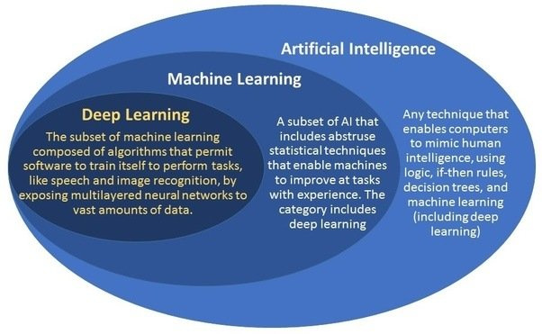
What is AI/ML/DL ?

Slide 7
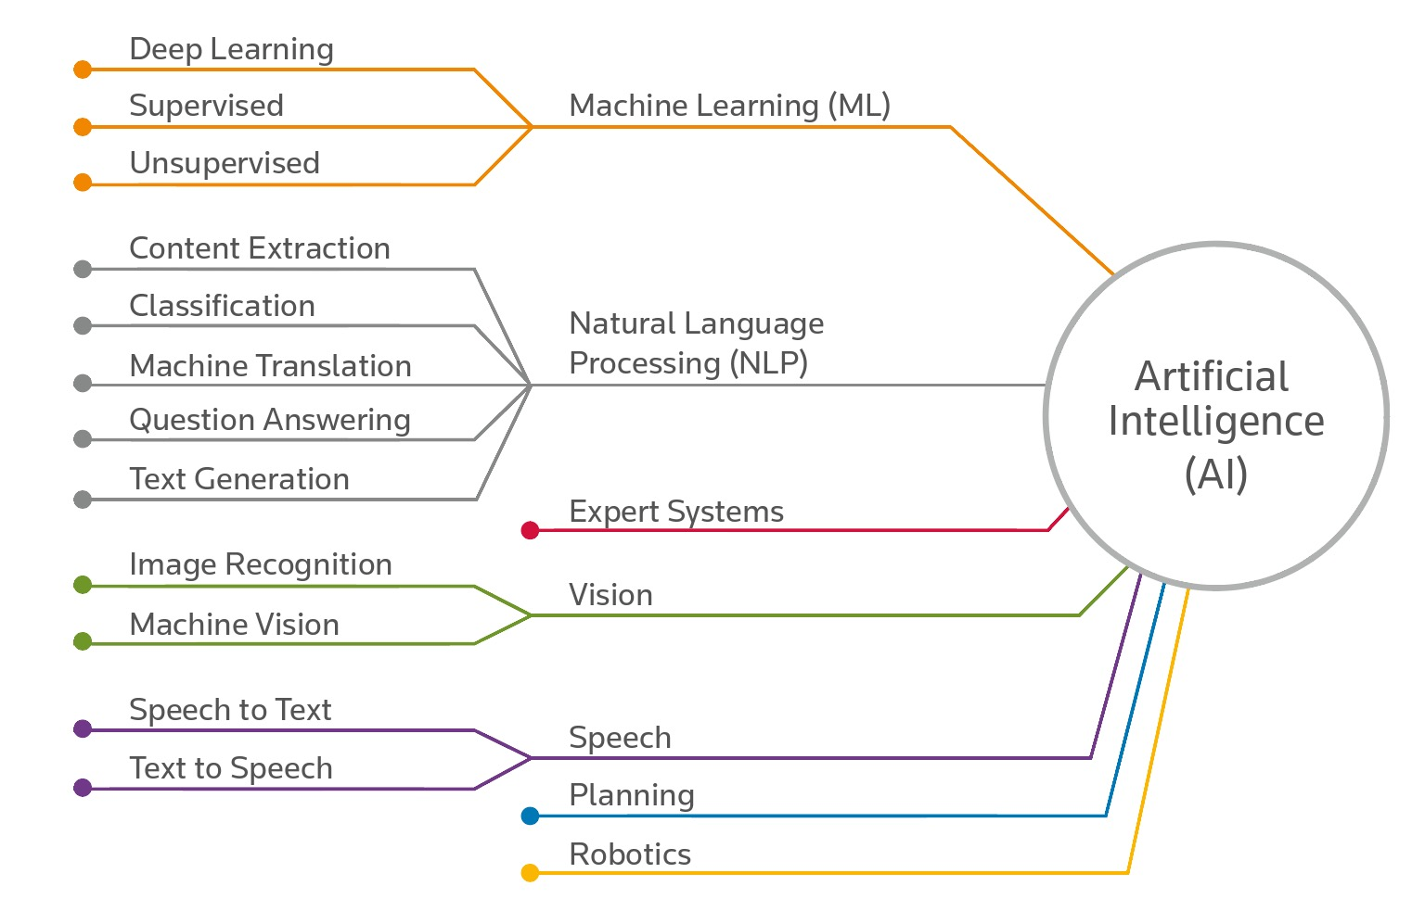
What is Artificial Intelligence ?

Slide 8
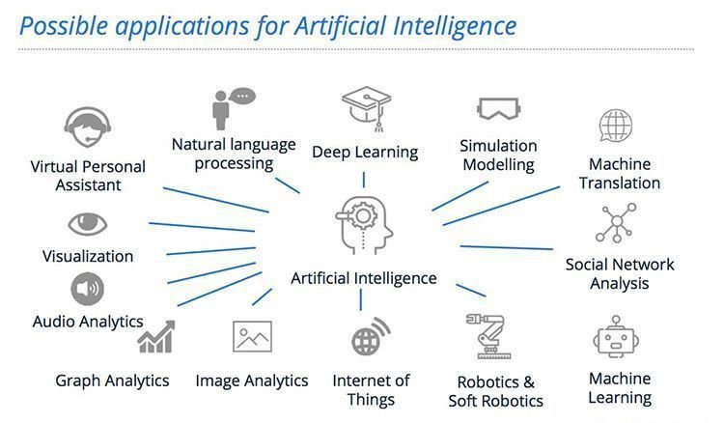
AI – History

Slide 9
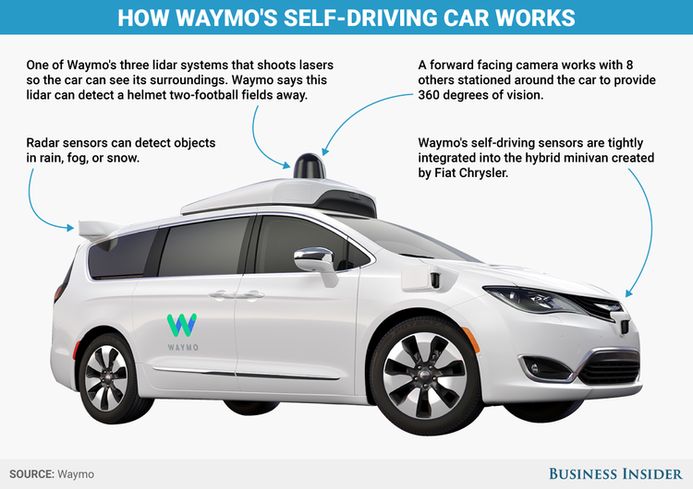
Google’s AI Products

Slide 10
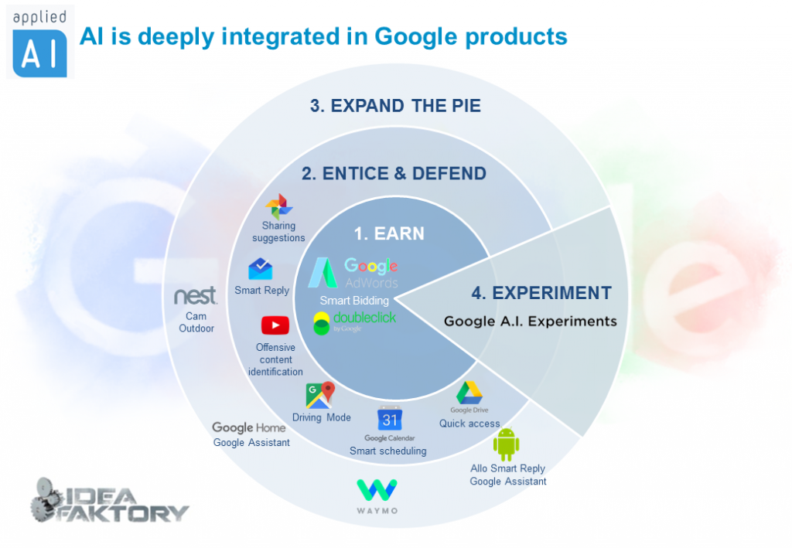
Google’s AI Products

Slide 11
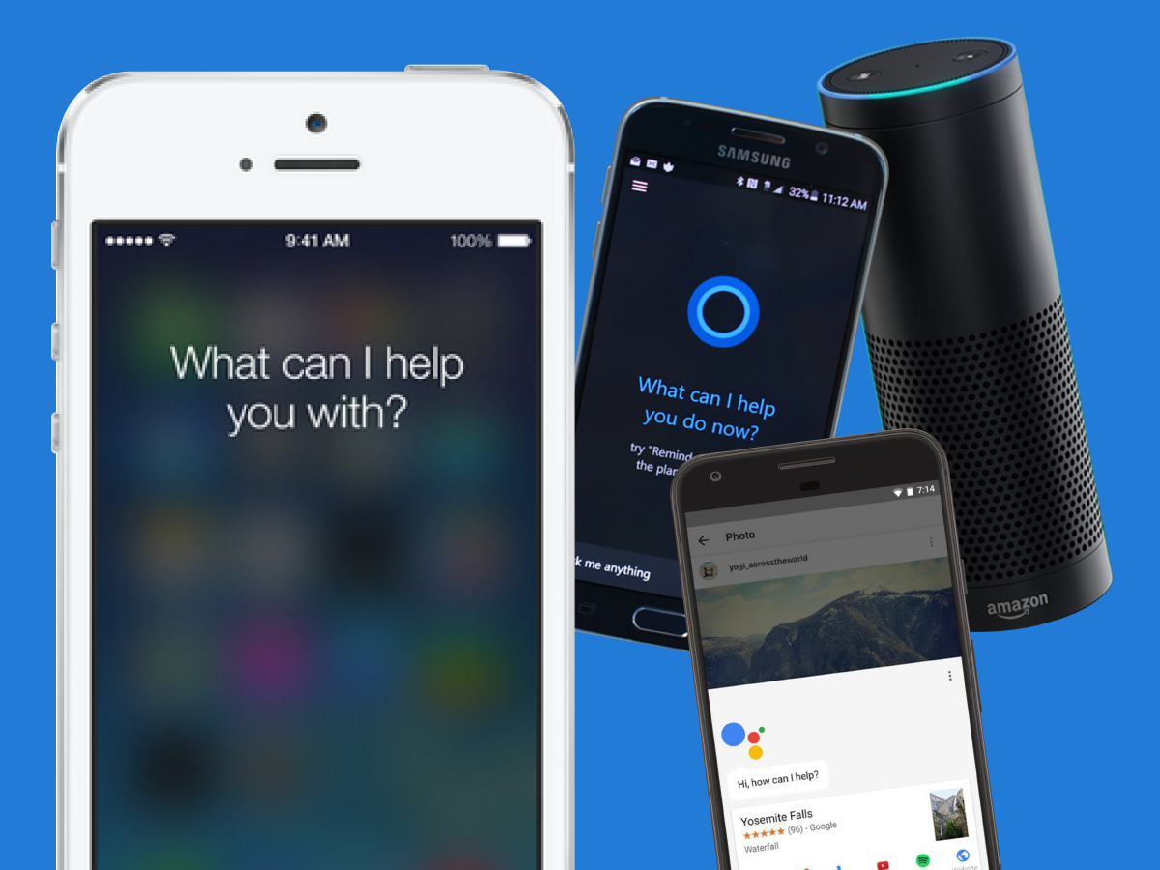
Personal Assistants

Slide 12

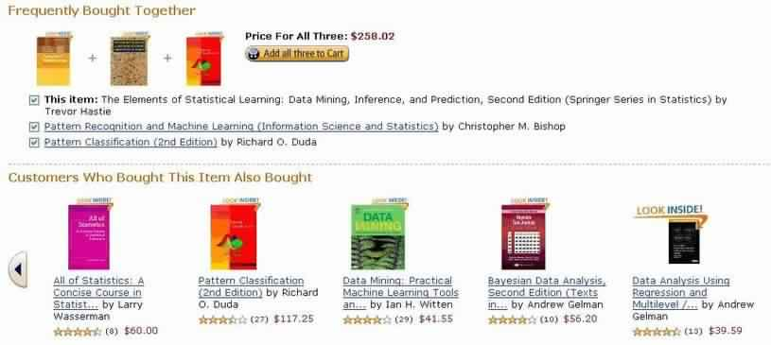
Recommendation Systems

Slide 13
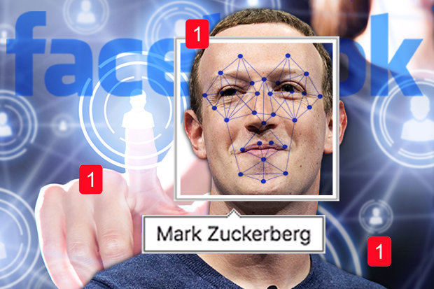
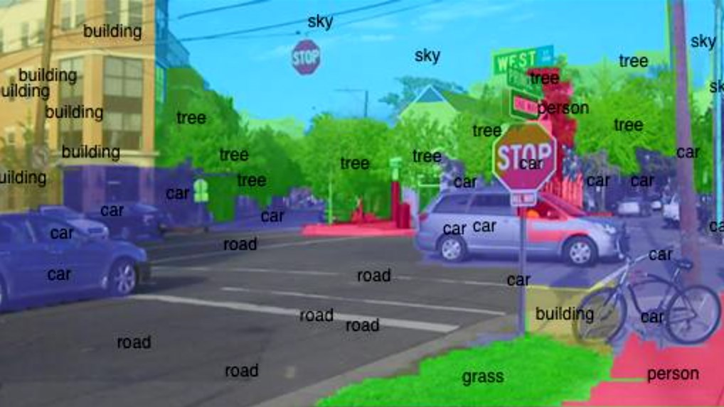
Face/Object detection

Slide 14


AI – Healthcare chatbots

Slide 15
AI – Impact on Healthcare
Keeping Well: New innovations like the smart belt, which warns people when they overeat, are helping to usher in a new era of preventative healthcare. The goal is to keep people well and to stop people from having to seek treatment in the first place.
Early Detection: When problems do occur, AI can help to spot them earlier. For example, Microsoft is developing computers that work on a molecular level to fight cancer cells as soon as they’re spotted. AI is also being used to analyze online search engine behavior to spot mental health issues.
Diagnosis: AI can help physicians to diagnose patients more quickly and arrive at insights based upon the 80% of health data that’s invisible to current systems because it’s unstructured.

Slide 16
AI – Impact on Healthcare
Decision-making: Clinical decision support systems and other AI-based tools can help doctors and patients to prioritize tasks. Examples include Quest Diagnostics’ Quanum and VitreosHealth.
Treatment: AI-based tools are already being used across the board. Google DeepMind is reducing the time it takes to plan radiotherapy treatment while IBM’s Watson is making treatment recommendations based on patients’ medical records around the world, including in China, Thailand and India.
End of Life Care: We’re living longer than ever, and our aging society is requiring more and more care at the end of their lives. AI-powered virtual assistants and even robots are being touted as the future, and indeed robots are already being used to care for the elderly in Japan.

Slide 17
AI – Impact on Healthcare
Research: AI can help to uncover new drugs and treatments, but it can also be used to research the diseases themselves, potentially allowing us to inoculate against them or to eliminate them. For example, Canadian start-up Meta uses AI to quickly analyze scientific papers and to provide easy insights.
Training: AI-powered simulations can help surgeons and other healthcare professionals to hone their craft without putting real patients at risk. AI models are generally more realistic and reliable, and one of the advantages of using AI for training is that it can tailor the training to each different individual.
https://hackernoon.com/ai-ml-and-big-data-in-healthcare-89c21f31ca9e

Slide 18
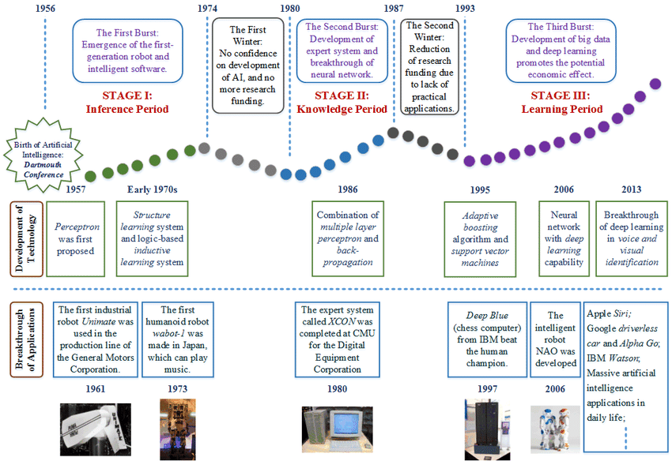
AI – History

Slide 19
Thank You
Raghu Prasad
9845547471
www.kaushalya.tech
FB : https://www.facebook.com/raghuprasadkonandur/
Skill Up-Skill Re-Skill
Excellence in action

